Slide 1
Storing & Managing Data
Jeremy Bergmann - Omaha Data Science Academy

Slide 2
Review: Class 6
Purpose of Database Modeling
Entity-Relationship Diagrams
SQL Constraints & Relational Database Modeling
Normal Forms: 1NF, 2NF, 3NF
Dimensional Data Modeling: Kimball
Database Modeling
Notes:
Feynman technique: Learn -> Explain -> Reflect -> Repeat
What are the most important ideas from last class? Write a summary of the information as if explaining to a 14 year old. Avoid jargon Keep the words and sentences simple Rely on memory Make the explanation visual, if possible Note where you had difficulty or have knowledge gaps. These indicate things you should review, research, or ask questions about

Slide 3
Project Milestones
Import data into MySQL database (Class 1)
Query Data for Data Understanding/Relevant Information (Class 2)
Storing/Joining data for analysis (Class 3-4)
Cleaning Data (Class 5)
Normalize Data & Create Data Model (Class 6)
Analyze Data Quality & Create Data Dictionary (Class 7)
Connect Data to PowerBI Desktop/Cloud, Answer Business Questions Automate data workflow using ETL (Python - Optional) (Class 8)

Slide 4
Class 7 Objectives
Data Storage Terminology
Data Management vs. Administration (DBA) Data Governance & Measuring Data Quality
Data Dictionaries
Notes:
Feynman technique: Learn -> Explain -> Reflect -> Repeat
What are the most important ideas from last class? Write a summary of the information as if explaining to a 14 year old. Avoid jargon Keep the words and sentences simple Rely on memory Make the explanation visual, if possible Note where you had difficulty or have knowledge gaps. These indicate things you should review, research, or ask questions about

Slide 5
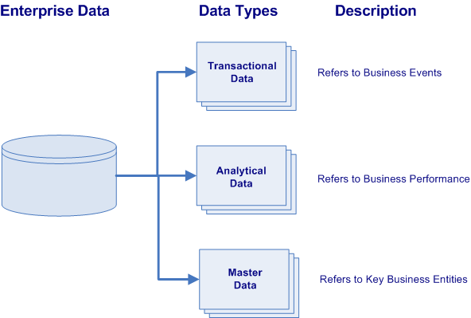
Types of Enterprise Data
All business enterprises have three varieties of physical data located within their numerous information systems. These varieties of data are characterized by their data types and their purpose within the organization.
Transactional Data describes the business events of an organization
Analytical Data supports decision making, reporting, query, and analysis (i.e. describes business performance).
Master Data represents the key business entities upon which transactions are executed and the dimensions around which analysis is conducted (i.e. describes key business entities).
Notes:
Transactional data supports the daily operations of an organization (i.e. describes business events).
Analytical data supports decision-making, reporting, query, and analysis (i.e. describes business performance).
While master data represents the key business entities upon which transactions are executed and the dimensions around which analysis is conducted (i.e. describes key business entities).
lowest granularity

Slide 6
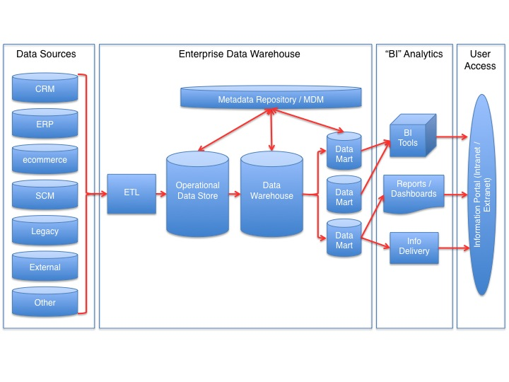
Data Storage Terminology
OLTP - Focused on the operation of a particular system - goal is to capture events.
ODS - “pulls together” data from multiple transaction processing systems and sources. Usually contains cleaned, “normalized” data
OLAP - capabilities to analyze data from multi-dimensional perspectives. Usually contains “denormalized” data
MDM: Define and manage the critical data of an organization to provide, with data integration, from a single point of reference.
Semantic Layer
(ODS)
Online Analytical Processing
(OLAP)
Online Transactional Processing
(OLTP)
Notes:
Relationship: OLTP = Source for OLAP

Slide 7
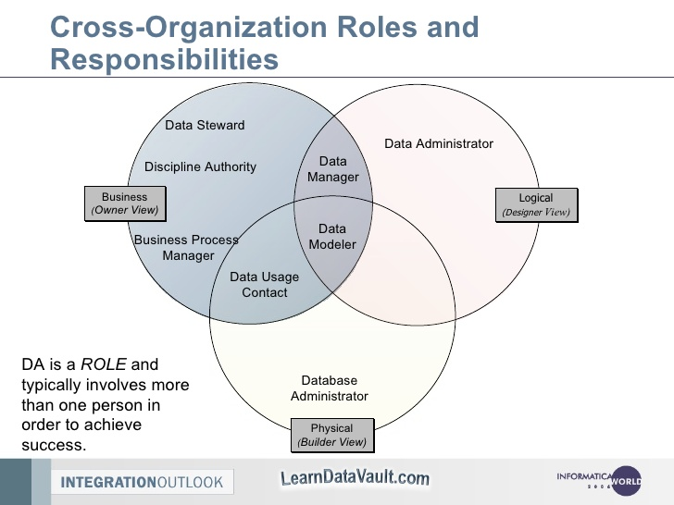
Data Management vs. DBA
What is Data Management?
Data Management (Stewardship) is the practice of organizing and maintaining data processes to meet ongoing information lifecycle needs. This includes data creation, storage, processing, archiving, and data destruction.
What is Database Administration (DBA)?
Database administration is the use of specialized software to store and organize data. This is the technical aspects of the planning, installation, configuration, design, migration, performance monitoring, security, troubleshooting, backup, and data recovery of a database system.
What are the Similarities Between the Two Roles?
Professionals in both specializations have to coordinate the database planning, goals, design, and communicate with each other while the project is being implemented.
What are the Differences?
Data management focuses on the “Logical” design - planning, organization, and design of a database system. DBA’s focus in the physical design of the database performance, storage, access, backups, etc.
Notes:
Approaches to data management eventually permeated what came to be known as the data lifecycle, spanning data creation, storage, processing, archiving and, sometimes, data destruction.

Slide 8
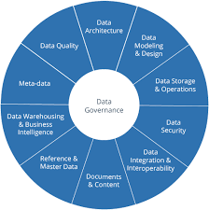
Data Governance
What is Data Governance?
Data Governance is a quality control discipline for assessing, managing, using, improving, monitoring, maintaining, and protecting organizational information.
Who Needs Data Governance?
Organizations that need to prevent sensitive information from being accessed by unauthorized users.
What is a Data Steward?
This is a position within an organization that ensures data governance processes are followed, guidelines are enforced, and recommends improvements to be made to data governance processes.
Notes:
It is a system of decision rights and accountabilities for information-related processes, executed according to agreed-upon models which describe who can take what actions with what information, and when, under what circumstances, using what methods

Slide 9
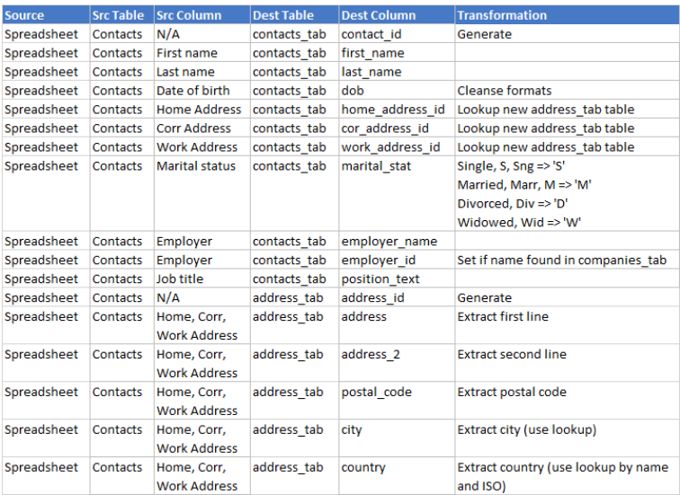
Data Dictionaries
What is a Data Dictionary?
A Data Dictionary is a collection of sources, names, definitions, and attributes about data elements that define the data captured in a system.
The data dictionary in general contains information about the following:
Names and physical information of all database schemas, tables and fields.
“System of record” information.
Table constraints such as primary key attributes, foreign key information etc.
Business rules, transformations and metadata about field values.

Slide 10
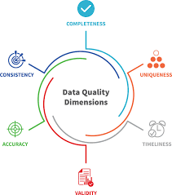
Measuring Data Quality
What is Data Quality?
Sometimes errors or incorrect elements are present in your data set. It’s important to be proactive and clean your data and periodically test it for inaccuracies.
What is a Data Quality Assessment?
You can identify these errors and understand their implications by both qualitative assessments and quantitative measurement. This ensures you have quality data on hand when you run your jobs. This will let you improve your data quality processes for quality and effectiveness.
What is an Example of Measuring Data Quality?
This is a common type of data quality metric. It allows you to track how the number of known errors – such as missing, incomplete or redundant entries – within a data set corresponds to the size of the data set. If you find fewer errors while the size of your data stays the same or grows, you know that your data quality is improving.

Slide 11

Class Project
Data Dictionary
1. Create a Data Dictionary for the “Consoles” schema, highlighting the original data source, database schema/table, fields values/types and business significance.
Power BI - Connect
1. Import the views you created in the “Consoles” schema into Power BI’s “Relationships” view.
2. Re-Create the entity relationships in last week’s ERD, by adding relationships via the data modeling view in Power BI.
Data Quality (Extra Credit)
1. Analyze Data Quality with Python code, via the Jupyter notebook (Python_DataQuality.ipynb) located in the “Examples” folder.
Notes:
If error that cant find python library: https://stackoverflow.com/questions/43437884/jupyter-notebook-import-error-no-module-named-matplotlib

Slide 12
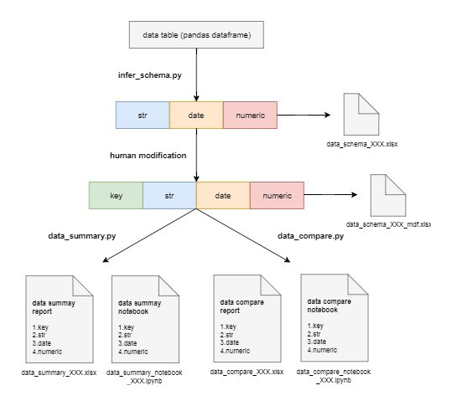
Appendix B: Data Quality w/Python
There are ways to monitor and measure data quality with Python. Some of these libraries can help with the following tasks:
Data Integration
Data Cleansing
Data Monitoring
Data Auditing
Investigating Unknown Datasets
To the right, you can see an example of a Python library: pydqc.
You can use libraries like this to set up a notebook to
import libraries like pandas to clean data, numpy to run
calculations, and pydqc to add automatic data quality checks.
It lets you load the data (CSV), infer the schema of your
database, and generate a summary of your data.
Library Documentation and Examples
https://github.com/SauceCat/pydqc
https://github.com/SauceCat/pydqc/blob/master/test/pydqc_test_on_Zillow.ipynb

